Slide 1

From pushing server cage nuts to pushing code
Sarah Lean – Cloud Solution Architect
@Techielass

Slide 2
My Career
Sarah
Lean
@Techielass

Slide 3
1st/2nd Level
IT Help Desk Operator
Service Desk Analyst
Systems Support Analyst
IT Technical Support
6 years
Sarah
Lean
@Techielass
Notes:
For the first 6 years of my career I worked in traditional 1st and 2nd level jobs.
I worked on help desks answering phones, resetting passwords, troubleshooting calls, learning how to log faults, learning customer service skills. Dealing with customers on the phone only taught me some valuable listening and customer service skills.
I built up my IT skills, college taught me a lot of background information but working on the front line, serving my apprenticeship in the 1st and 2nd line jobs is where I learned all base knowledge. Knowledge I still leverage today when I’m dealing with customers or listening to customers.

Slide 4

Sarah
Lean
@Techielass
Notes:
Yes a lot of that time was a bit like this, but it served me well.
I spent a lot of time on different technologies.

Slide 5
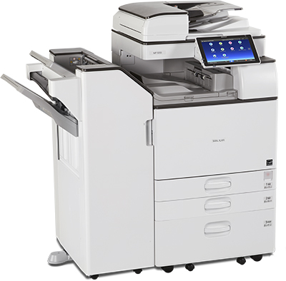

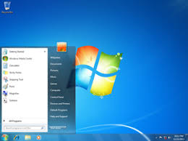
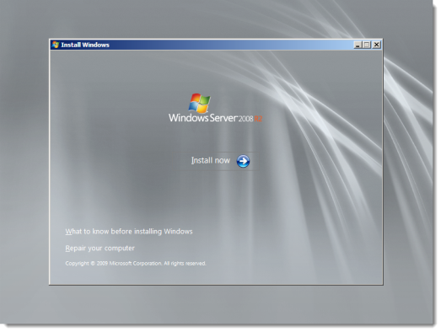

Variety
Sarah
Lean
@Techielass
Notes:
I used a variety of technology during that time. Mostly Microsoft technology.
I had fun and games with printers, paper jams and toners. They always seem to explode on you when you are wearing white, right? lol

Slide 6
3rd Level/Consultant
Service Consultant
Technical Team Leader
Technical Consultant
Wintel Engineer
6 years
Sarah
Lean
@Techielass
Notes:
After those 6 years I moved into 3rd level roles or consultancy roles. By this time I was working for managed service providers. So I was in a “different” world as such, I was no longer working within a specific IT department.
This is where I started to design and build systems from scratch for customers. I learnt how to spec systems, how to answer RFPs, how to “sell” systems and services.

Slide 7

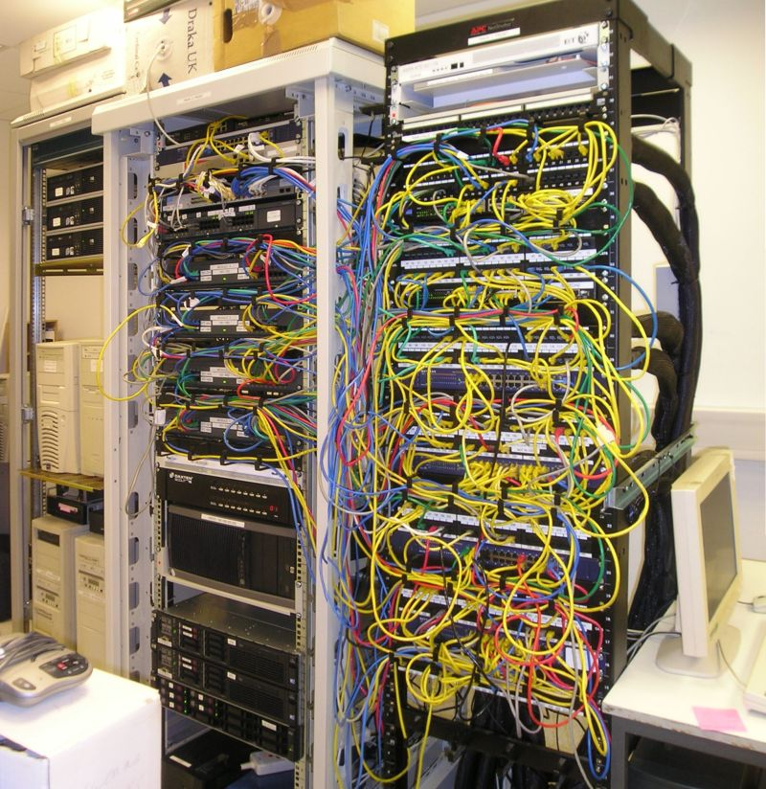
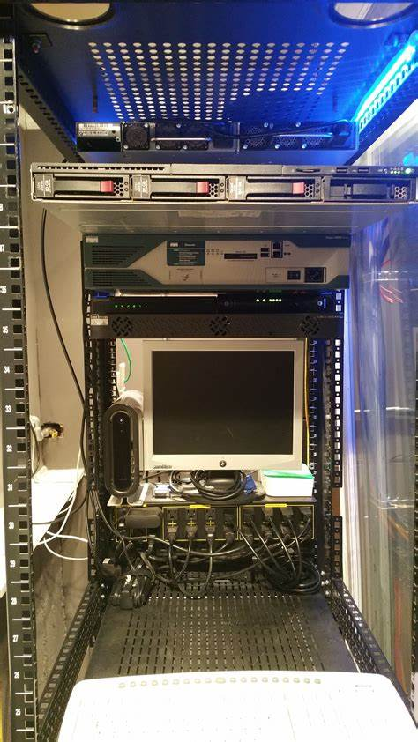
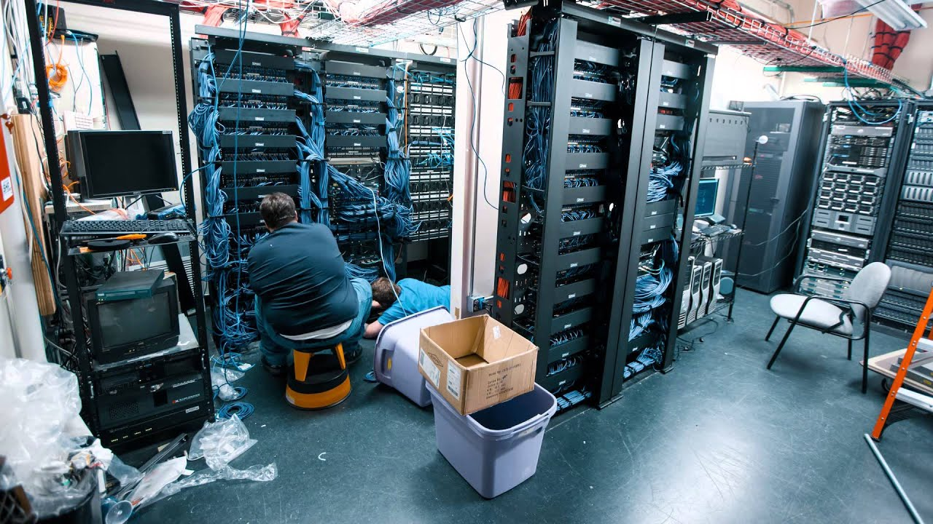
Sarah
Lean
@Techielass
Notes:
This is the types of places that I started to spent time in.
These pictures are ones I’ve found on the Internet, and these are slightly more glamourous than the ones I spent time in. lol We’ve all been in them right? All spent time in the cold aisles with a tons of layers on trying to stay warm or fighting with messy cables and cable management arms?
Server rails and server cage nuts that don’t line up? That rip skin off your hands?
I remember a couple of times where I’ve had to sit in drafty server rooms for days at a time setting up servers, installing operating systems, fighting with drivers, proprietary software. Not necessarily fun at the time, but all great experiences and great for building up my skillset.

Slide 8
Hardware
Sarah
Lean
@Techielass
Notes:
My focus at that time was hardware, deploying IT infrastructure with physical hardware. There was one time I could tell you about HP’s servers, the options, rough prices, how to work bios’s without seeing them, how to use their property software to install OS’s again without looking at them but that all changed in 2017.

Slide 9






Sarah
Lean
@Techielass
Notes:
In 2017 I joined a company that was focussing on the cloud more than on premises deployments. They were a small organisation and I was brought on to help bring my knowledge of on premises systems and work with another of their engineers who was a “born in the cloud” engineer.
We had customers who had the “usual” datacentres for their business but were looking to adopt Office 365, and Azure services for things that were nearing end of life or could add value to their business.
We were working together to use our combined knowledge to design and implement solutions for them.

Slide 10
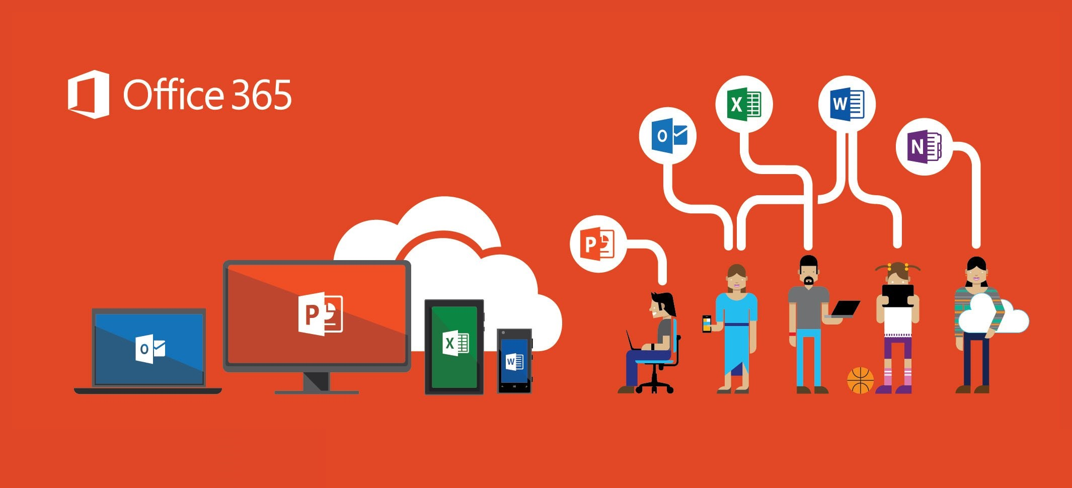
Sarah
Lean
@Techielass
Notes:
Office 365 moves and change adoption was something that we worked on. And helped several councils and private organisations during my time within the company.
Upskilling each other as we went along the journey.

Slide 11

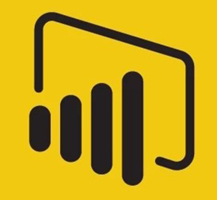
Azure IoT Project
Sarah
Lean
@Techielass
Notes:
We worked with a customer to create an IoT sensor project that helped them monitor their fridge temperatures and record them.
We use an IoT hub, stream analytics, CosmosDB and PowerBI. That was a massive challenge, as I’d never used any of those technologies before or looked at IoT sensors so we were all learning there, but at the end of it, we came up with a working solution for the customer.
It was a great, learn to swim or drown type scenario.
We hit some limitations with the tech and our skill set but the customer was looking forward to having a solution that wasn’t based on site and wasn’t reliant on IT checking it and being the point of contact for it and the right people in the org could see the report and data when they needed.

Slide 12
Azure Backup/Azure Site Recovery
Sarah
Lean
@Techielass
Notes:
Another project that I helped to cut my teach on was Backup and DR.
A customer had multiple sites in the UK, Dubai and Asia. They had issues with tapes and people not changing them or losing them or they became corrupt.

Slide 13

Mentor & Mentee
Sarah
Lean
@Techielass
Notes:
I was both a mentor and mentee during my time at this company.

Slide 14

https://www.gaug.co.uk
https://aka.ms/azurefamily
Sarah
Lean
@Techielass

Slide 15

Sarah
Lean
@Techielass
Notes:
Joining Microsoft in 2018 as a Cloud Solution Architect

Slide 16
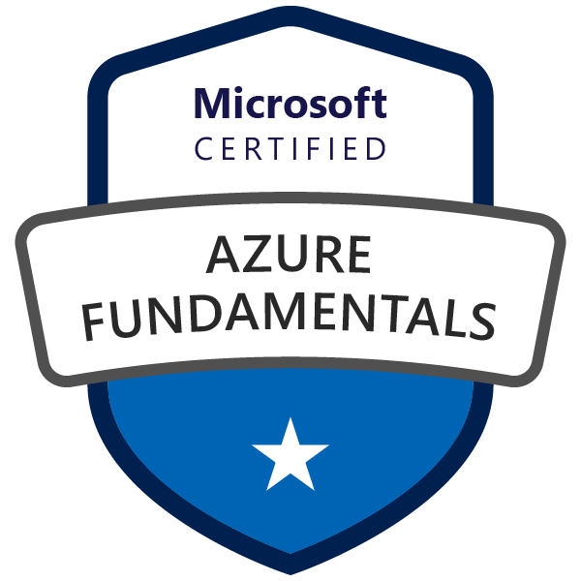
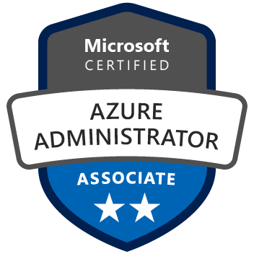

Earning my badges
Sarah
Lean
@Techielass

Slide 17
Coding
Sarah
Lean
@Techielass

Slide 18

Sarah
Lean
@Techielass
Notes:
This was probably something we were all told a while ago right? We were probably all safe and sound in our wee bubble of using GUIs and not really coding? We’d got out the way of it right? Then whoosh in comes Exchange 2007 with it half GUI and PowerShell mix of admin. And that’s maybe when we all started to take notice and do things within the PowerShell interface? Or maybe it was Server Core in 2008 that got you started?
That’s how I got started, that’s how I started to code again. Now I’m not an expert in any shape or form and I often have to refer to documentation for the commands or commands syntax and my scripts aren’t the best but what I do write works, so that’s a bonus right?
PowerShell is a language we probably all know, or are comfortable dabbling in.

Slide 19
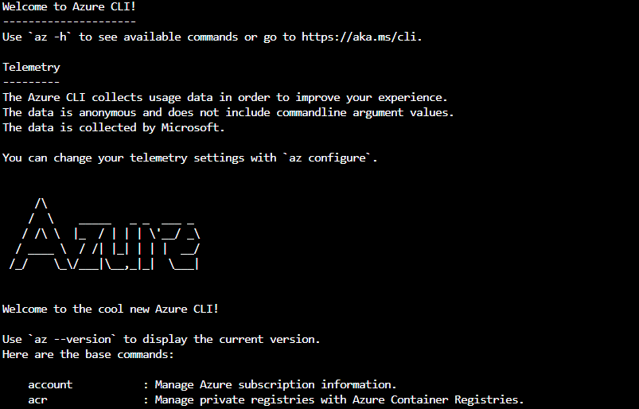
Sarah
Lean
@Techielass
Notes:
Azure CLI, released in 2016, was my next flurry into coding.
Working with Azure it’s one of the native ways to deploy resources and can be a repeatable method to deploy resources or multiple resources.

Slide 20
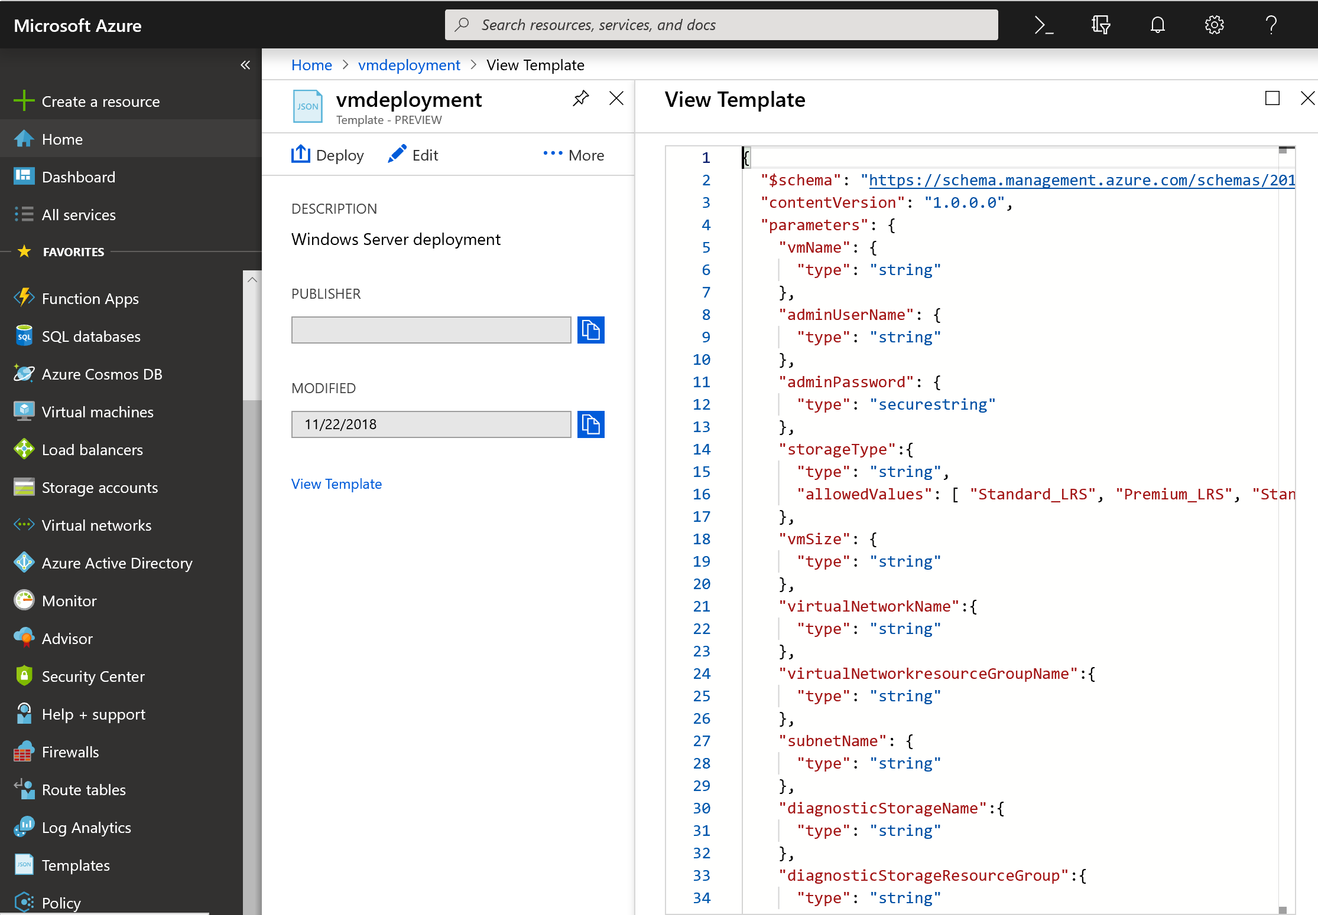
Sarah
Lean
@Techielass
Notes:
ARM Templates

Slide 21
Don’t ignore it.
Sarah
Lean
@Techielass
Notes:
Don’t ignore the coding side of things, we still have GUI’s but as we’ve seen over the years sometimes we need to learn how to code to get the full features of a product. Don’t ignore learning a language, I’m not saying you need to be a guru in it but at least have a basic understanding of a language and build on it as time goes on.

Slide 22

Azure DevOps
Sarah
Lean
@Techielass

Slide 23





Introducing Azure DevOps
Azure Boards
Azure Pipelines
Azure Repos
Deliver value to your users faster using proven agile tools to plan, track, and discuss work across your teams.
Build, test, and deploy with CI/CD that works with any language, platform, and cloud. Connect to GitHub or any other Git provider and deploy continuously.
Get unlimited, cloud-hosted private Git repos and collaborate to build better code with pull requests and advanced file management.
Azure Test Plans
Azure Artifacts
➔
Test and ship with confidence using manual and exploratory testing tools.
Create, host, and share packages with your team, and add artifacts to your CI/CD pipelines with a single click.
https://azure.com/devops

Slide 24
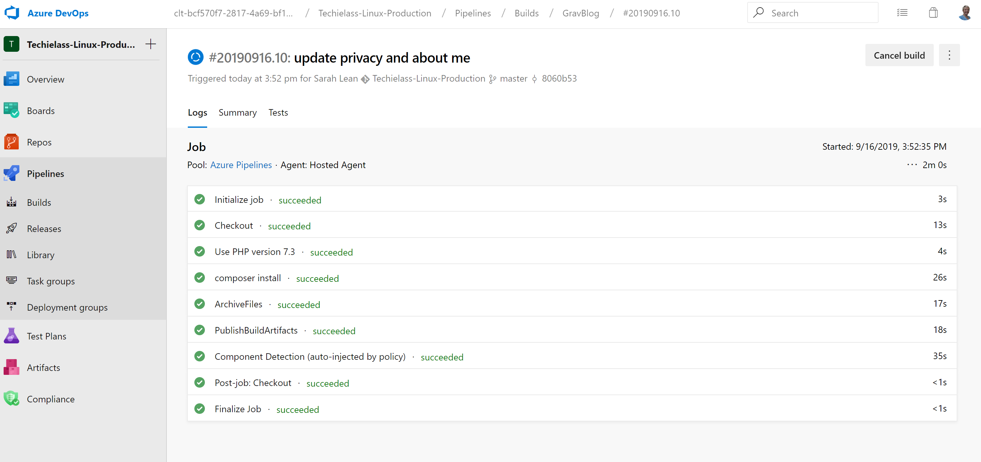
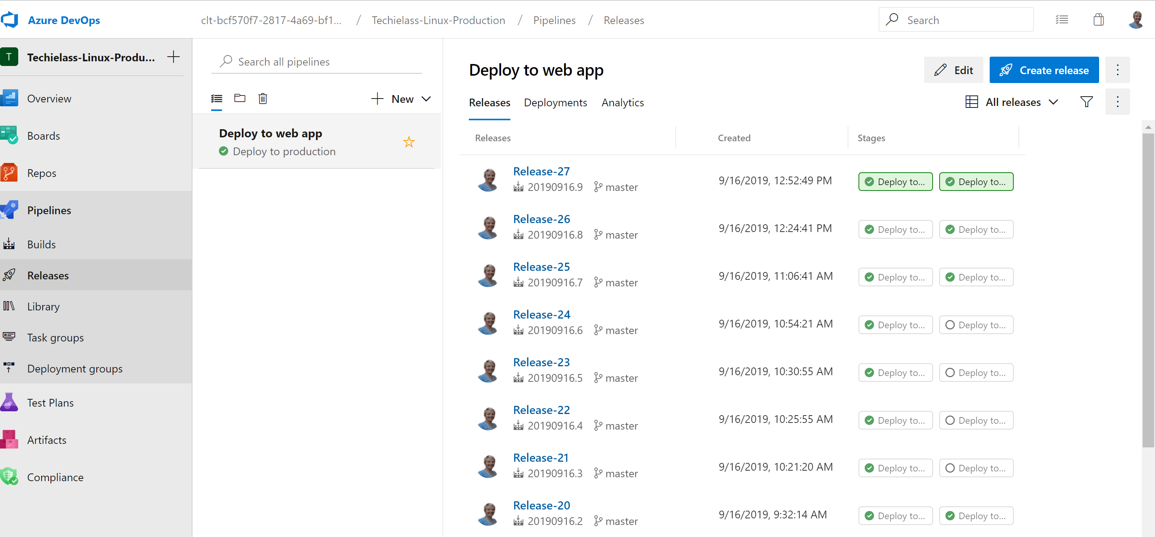
Sarah
Lean
@Techielass

Slide 25
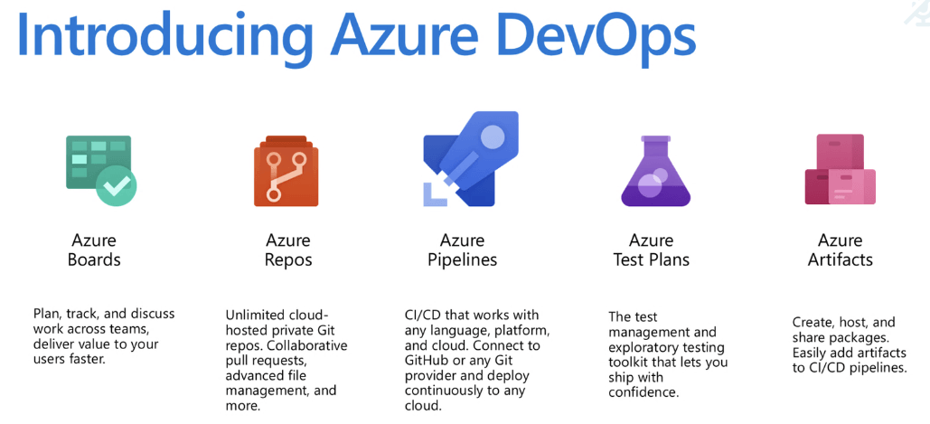
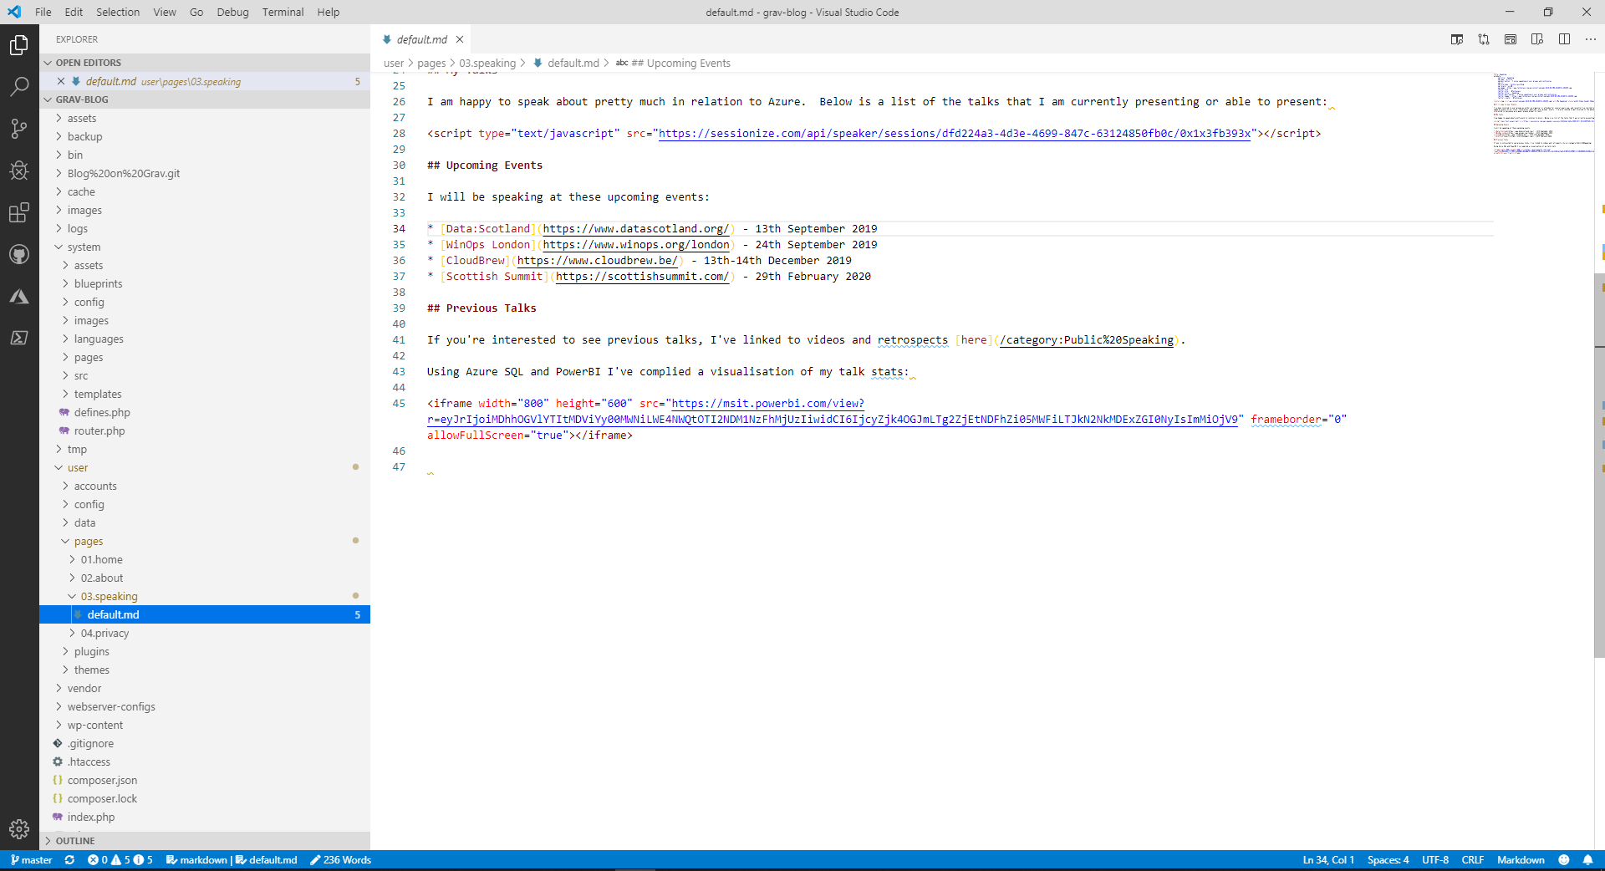
Azure DevOps Repo
Azure DevOps Pipeline
Azure Web App - Development Slot
Azure Web App -Production Slot
Visual Studio Code
Sarah
Lean
@Techielass

Slide 26
Still learning.
Sarah
Lean
@Techielass
Notes:
What I’m doing in DevOps isn’t perfect and isn’t necessarily what I would recommend in a proper production environment. But I am learning and I’m learning from mistakes, I am learning from doing.

Slide 27
Mentor & Mentee
Sarah
Lean
@Techielass
Notes:
I’m now helping others in my team negotiate, git, github, devops, and figure out. While advancing my skillset by speaking to others that are more advanced than me.

Slide 28
Keep up to date
Sarah
Lean
@Techielass

Slide 29




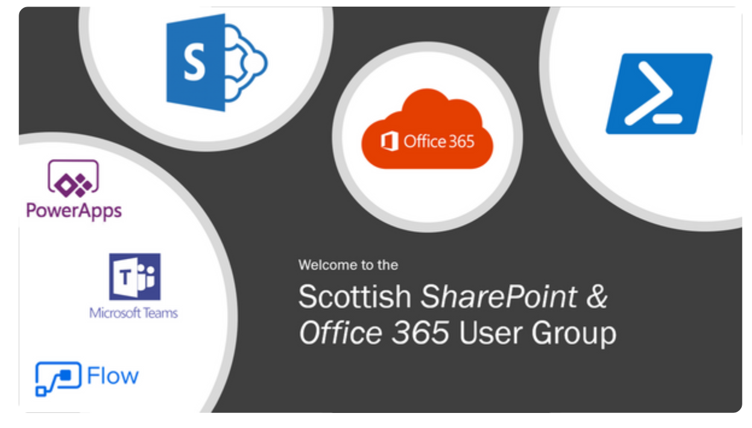
Notes:
User Groups, conferences. I invest in them, I go to them, I publicise them, I check what talks are being made to see trends.

Slide 30

#azurefamily
#sqlfamily
#mvpbuzz
#azops
#itops

Slide 31



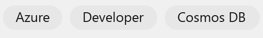
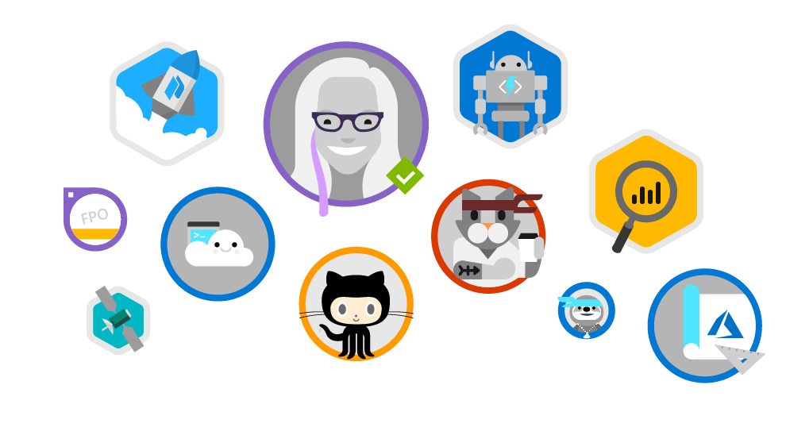
Microsoft Learn
www.microsoft.com/learn
Step-by-Step Learning
Gamification & Achievements
Friction-Free Learning
Guided microlearning by product/service, difficulty, job role, etc
Videos, tutorials, and hands-on learning
Role-based learning paths to prepare for certification
Unlock achievements
Task-based achievements to reward your hands-on skills
Customizable user profile
All learning content is free
Content available in the spoken language and programming language of my choice
No-install, browser-based Interactive coding/scripting environments
All scripts and code samples available for download
Sarah
Lean
@Techielass
Notes:
I spend a lot of time learning, or refreshing my skills, and I use Microsoft Learn for a large chunk of it. It’s free and easy to access.

Slide 32
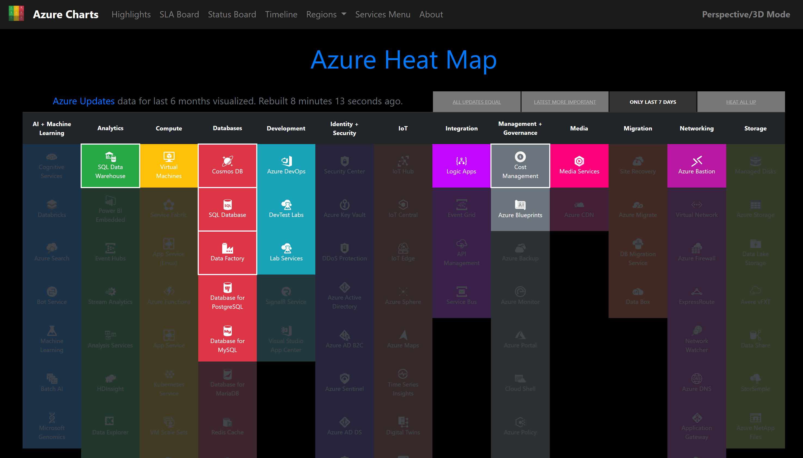
https://azurecharts.com/?vm=lxd
Sarah
Lean
@Techielass

Slide 33
Summary
Sarah
Lean
@Techielass

Slide 34
What you know now is still relevant.
Sarah
Lean
@Techielass

Slide 35
Be open to new opportunities.
Sarah
Lean
@Techielass

Slide 36
Find something you enjoy and learn it.
Sarah
Lean
@Techielass

Slide 37
Don’t try to do too much.
Sarah
Lean
@Techielass

Slide 38
Believe in yourself.
Sarah
Lean
@Techielass

Slide 39
Enjoy!
Sarah
Lean
@Techielass

Slide 40
My journey has been an evolution, because I’ve been open to new opportunities.
Sarah
Lean
@Techielass

Slide 41
Thank you | Q&A
@Techielass
Sarah
Lean
@Techielass

